Slide 1
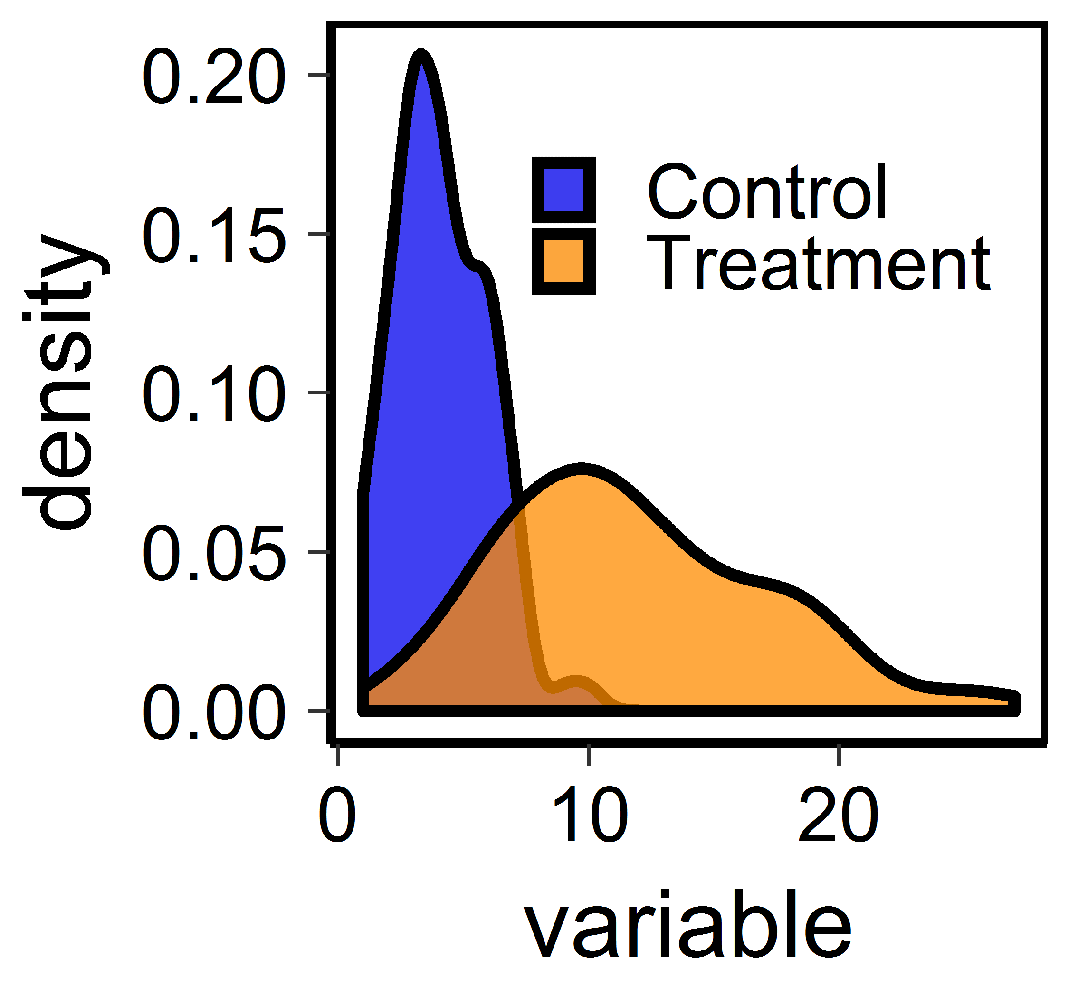
Linear Models in Agriculture and Natural Resources

Slide 2
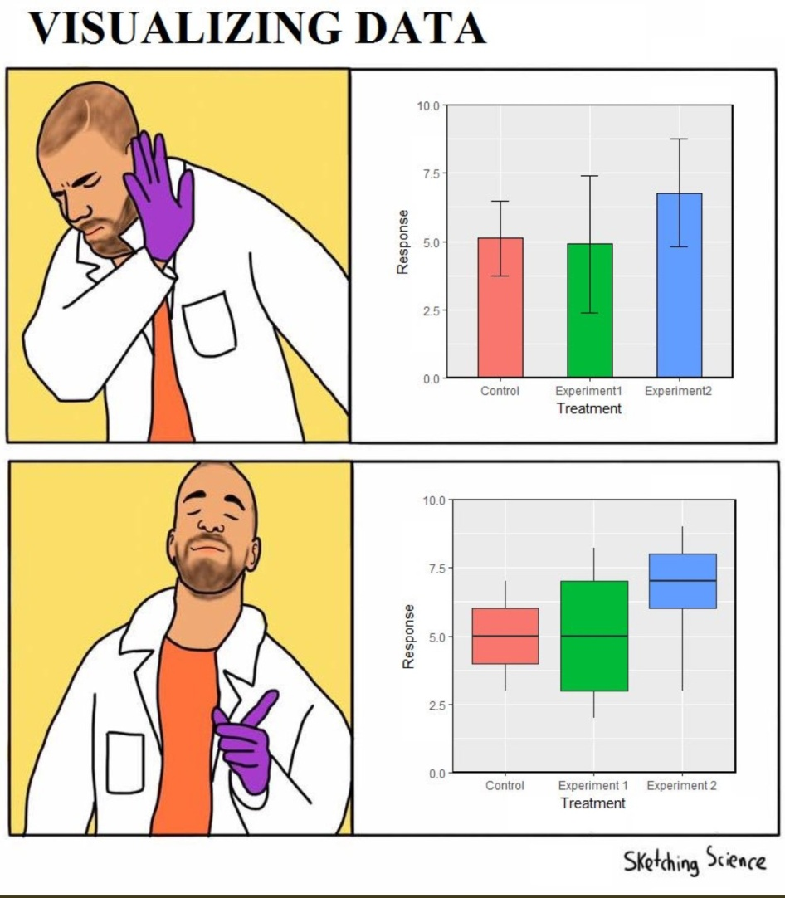
Visualizing data
What information do we want to communicate in a graph?
Values of the data
Means of groups or relationships between variables
Variance (or error) around estimated means or relationships

Slide 3
Types of data
Qualitative
Quantitative

Slide 4
Types of data
Qualitative
Quantitative
Categories or groups
Species or populations or cultivars
Experimental treatments
+/-pesticide
+/-invasive plant removal
Diet type
Continuous values
body mass or size or trait
Counts of insects
Experimental treatments
Doses of pesticide
Nitrogen fertilizer amounts

Slide 5
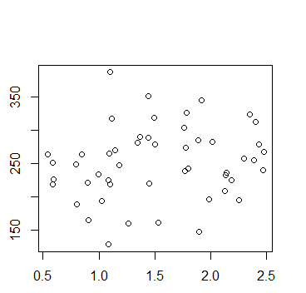
Visualizing continuous data: relationships between two variables
y-axis:
Response variable
Dependent variable
X-axis: predictor variable
Independent variable

Slide 6
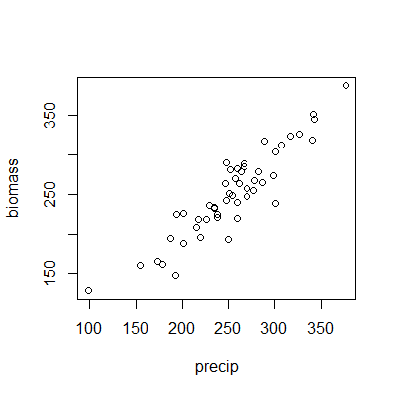
Visualizing continuous data: relationships between two variables
Is there a relationship between biomass and precipitation?

Slide 7
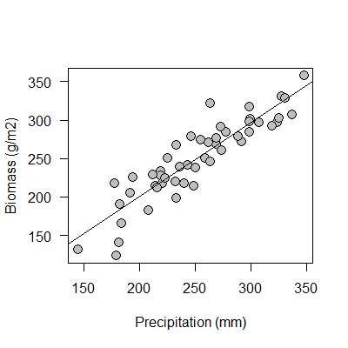
Visualizing continuous data: relationships between two variables
Is there a relationship between biomass and precipitation?

Slide 8
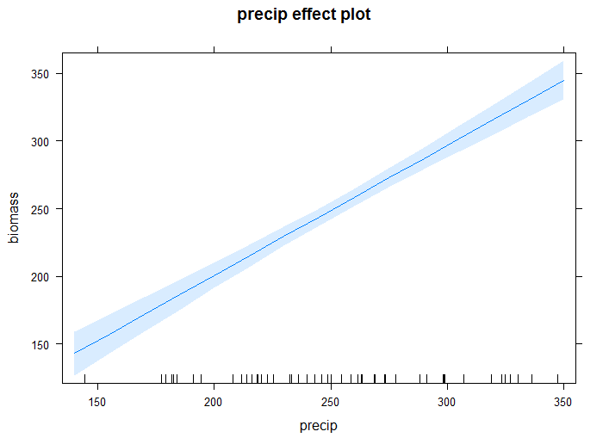
Visualizing continuous data: relationships between two variables
Is there a relationship between biomass and precipitation?

Slide 9
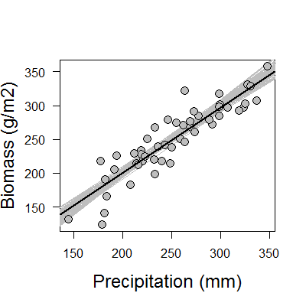
Visualizing continuous data: relationships between two variables
Which is most effective?
A
B
C

Slide 10
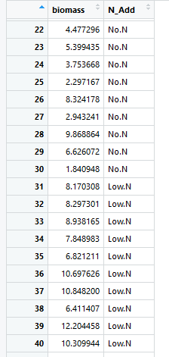
Visualizing categorical data: relationships among groups

Slide 11
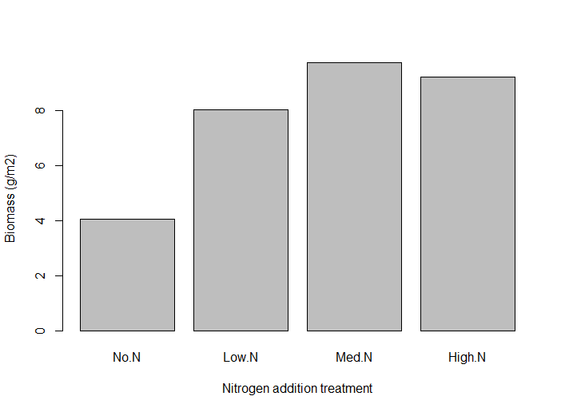
Visualizing categorical data: relationships among groups

Slide 12
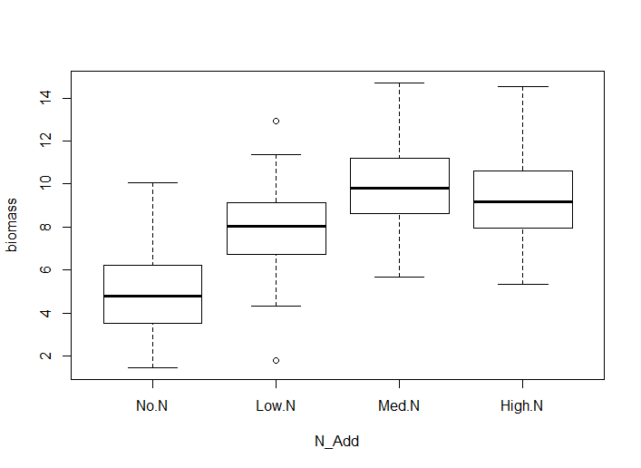
Visualizing categorical data: relationships among groups

Slide 13
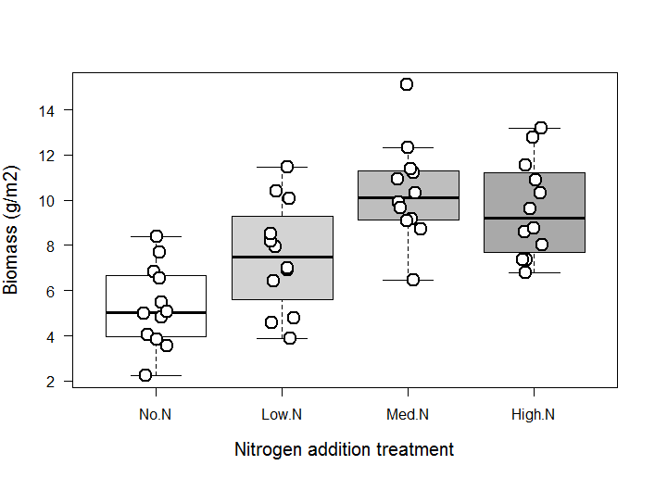
Visualizing categorical data: relationships among groups

Slide 14
Visualizing categorical data: relationships between two variables
Which is most effective?
A
B
C

Slide 15
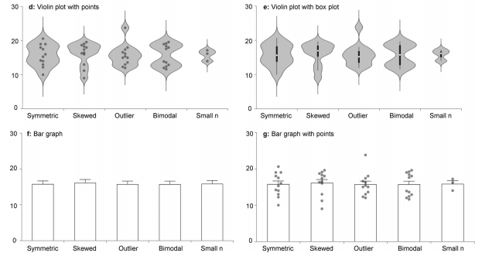
Visualizing categorical data: problems with bar graphs
What is the difference between these datasets?
Set 1 Set 2 Set 3 Set 4 Set 5

Slide 16
Visualizing categorical data: problems with bar graphs
Set 1 Set 2 Set 3 Set 4 Set 5

Slide 17
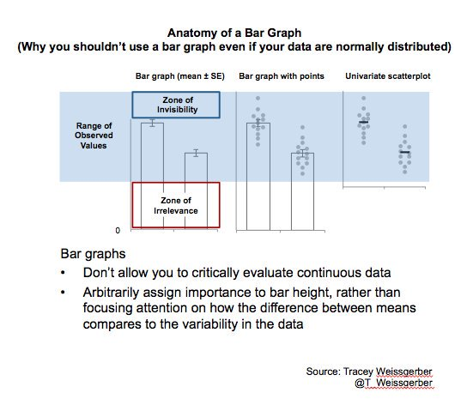

Slide 18
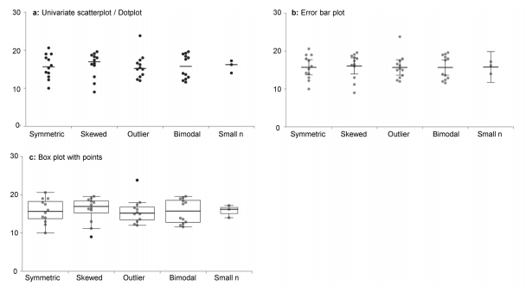
Visualizing categorical data: relationships between two variables
Which is most effective?
Weissgerber et al. 2017

Slide 19
Data visualization: key points
Show your data!
Go beyond the default settings
Clear labels, large fonts, good colors

Slide 20
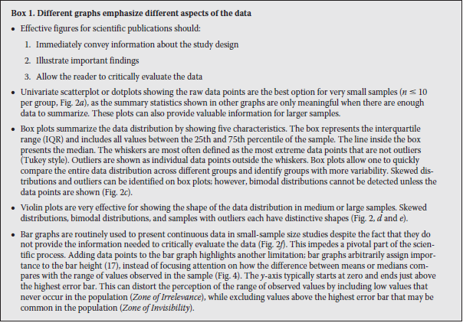
Weissgerber et al. 2017, J. Biol. Chem.
Notes:
https://docs.google.com/document/d/1PAPTN7thxa8-g5pijxs0GuQ4Y1umF2zk5ZaoJ8Ya9fI/edit?usp=sharing

Slide 21
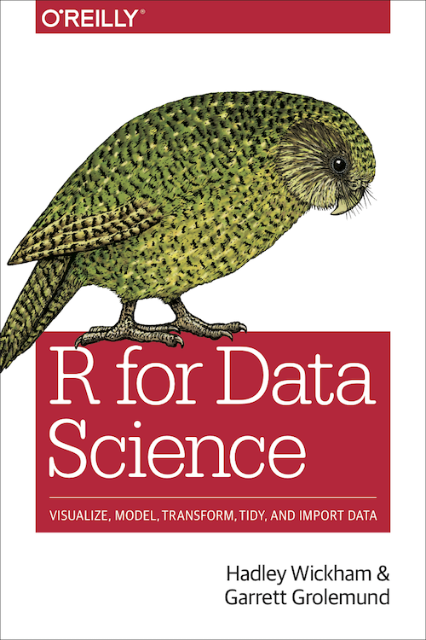
https://r4ds.had.co.nz/

Slide 22
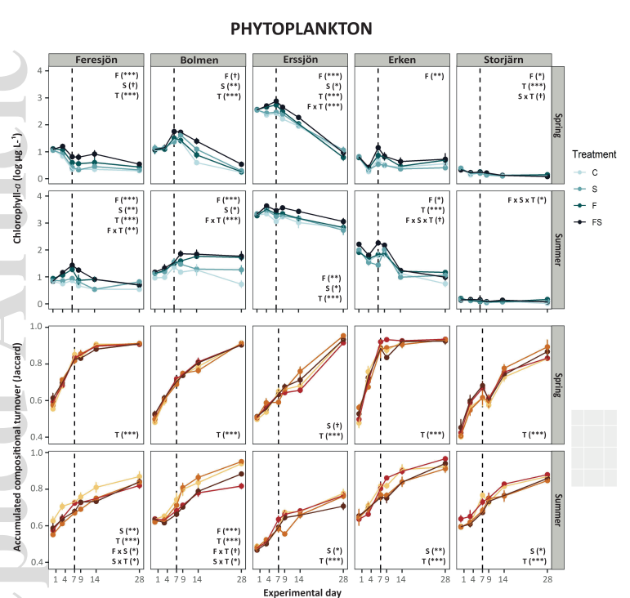
Cordero et al. 2021 Ecology

Slide 23
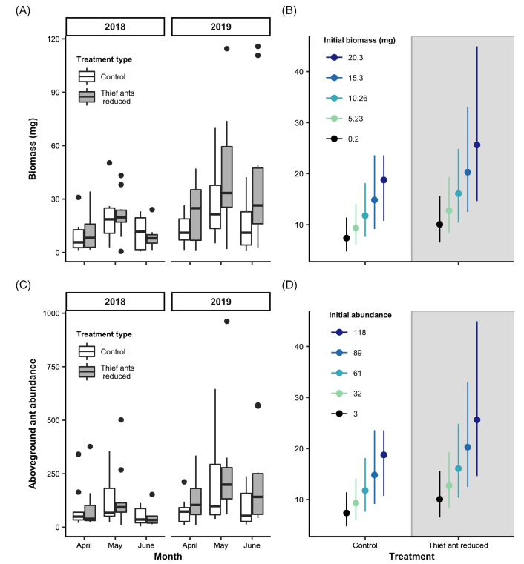
Ohyama et al. 2020 Ecology

Slide 24
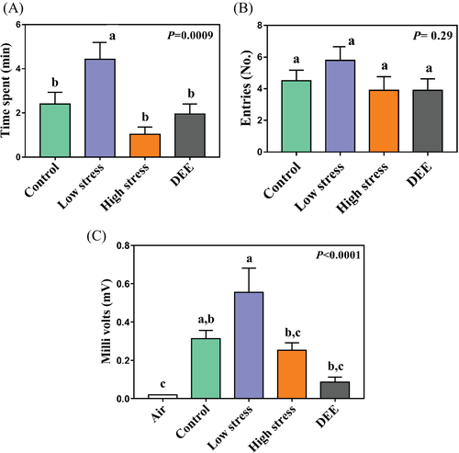
Damoaram et al. 2021 Ecological Entomology

Slide 25
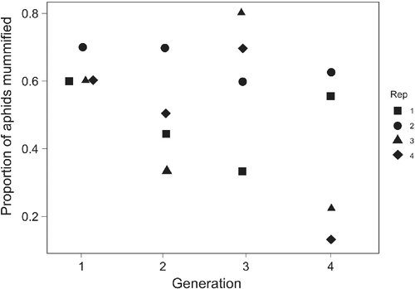
Uriel et al. 2021 Ecological Entomology

Slide 26
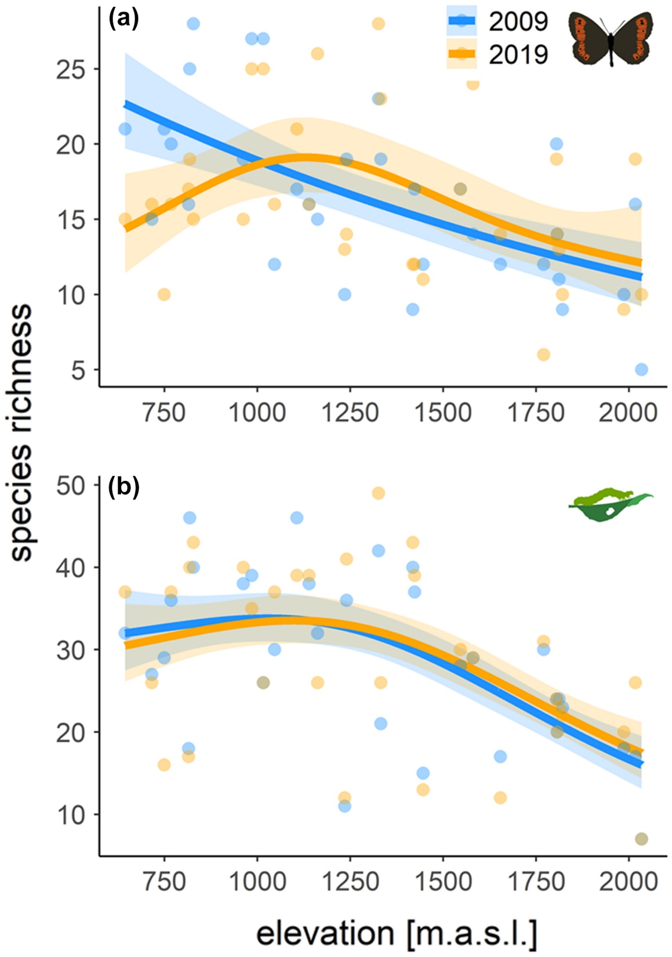
Kerner et al. 2023
Ecology

Slide 27
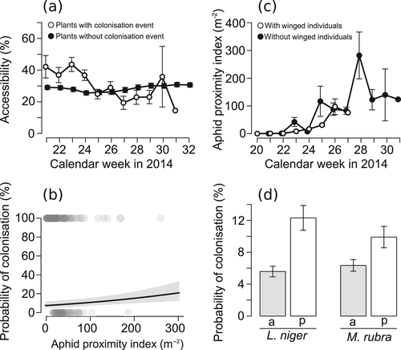
Senft et al. 2021 Ecological Entomology

Slide 28
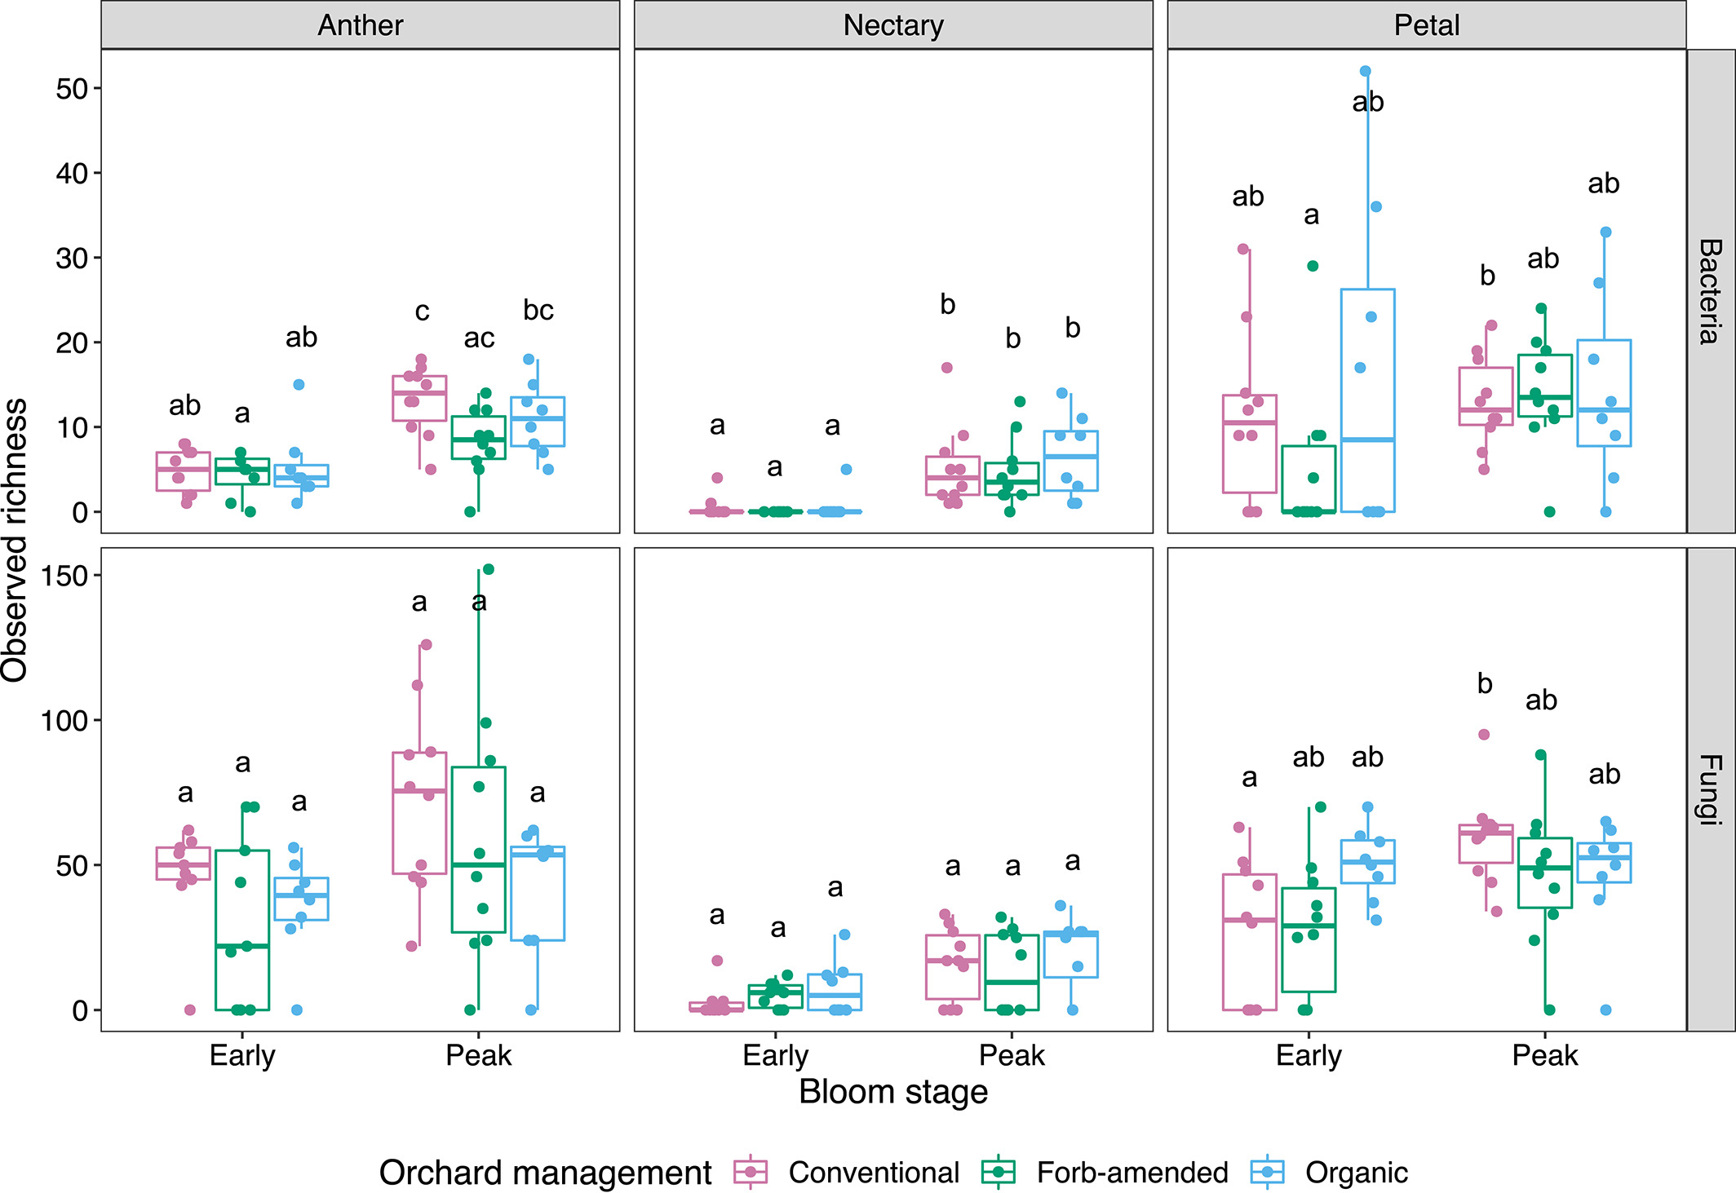
Schaeffer et al. 2023
J Applied Ecology

Slide 29
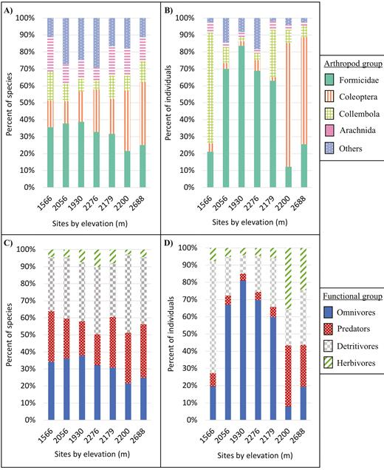
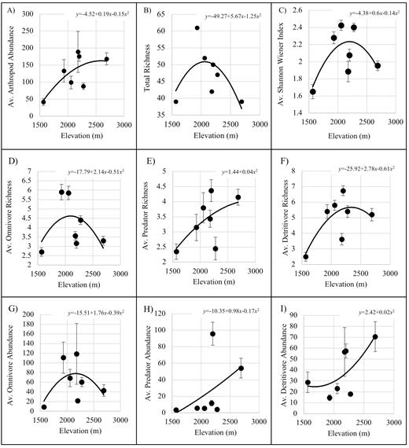
Uhey et al. 2021 Environmental Entomology

Slide 30
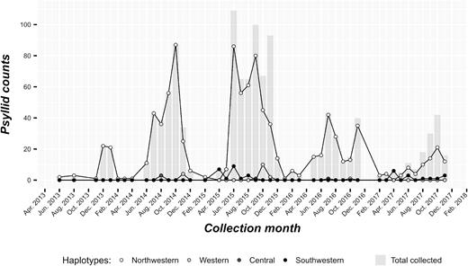
Dahan et al. 2021 Environmental Entomology

Slide 31
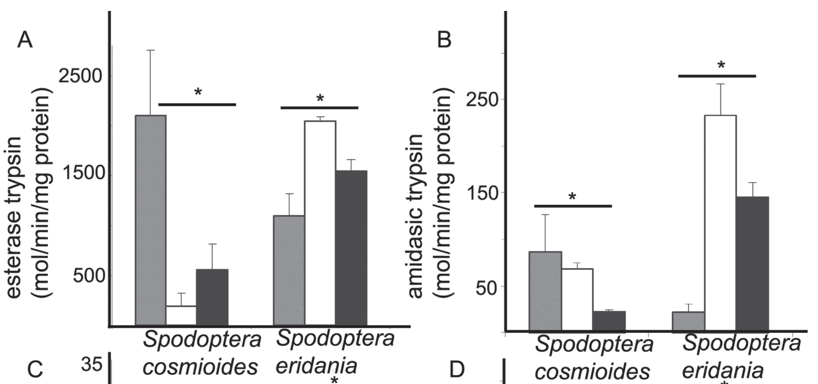
Rocha et al. 2021
Florida Entomologist

Slide 32
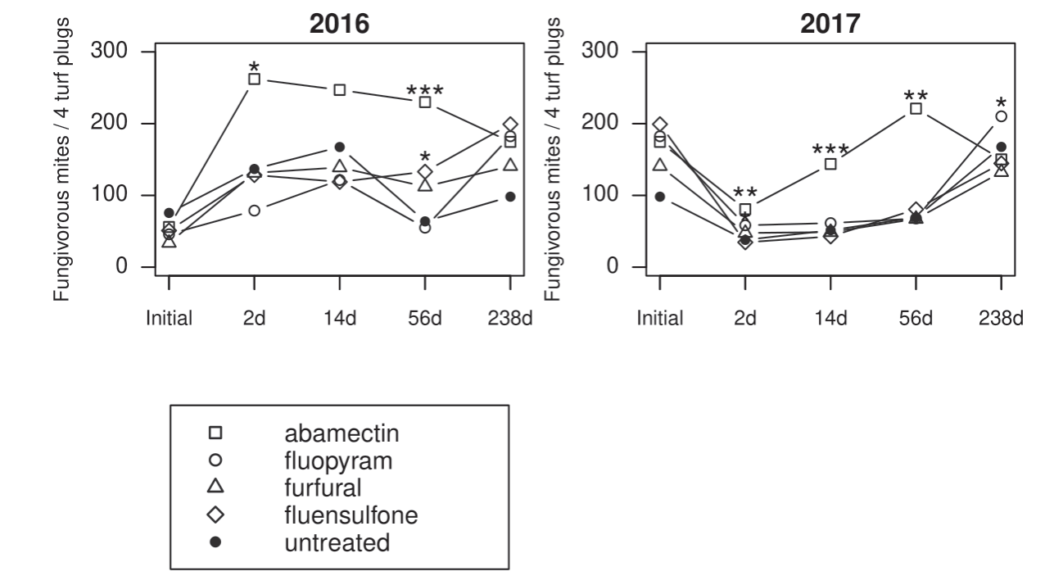
Waldo et al. 2021
Florida Entomologist

Slide 33
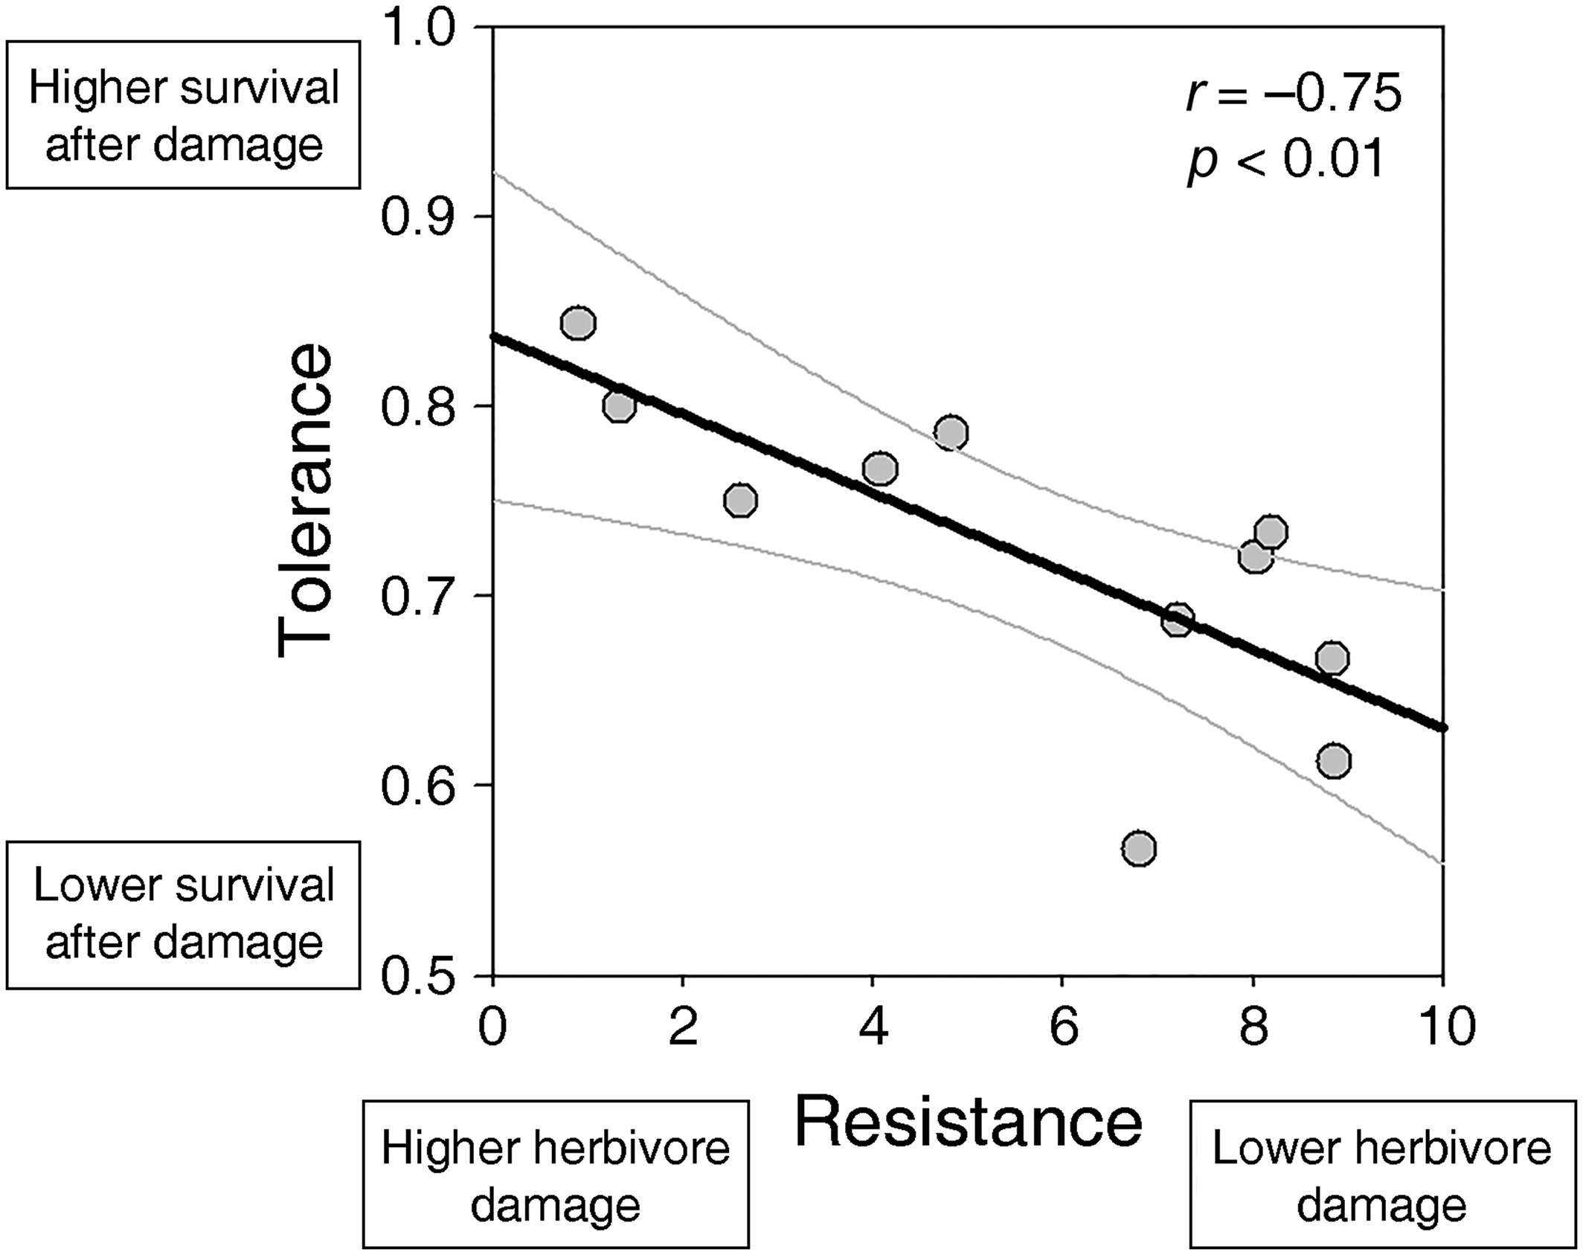
Salgado-Luarte et al. 2023
Ecology

